Slide 1
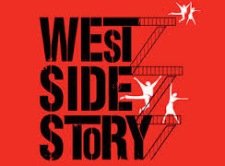
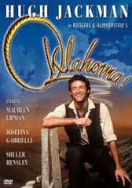
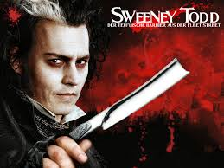
Unit 10
The American Musical

Slide 2

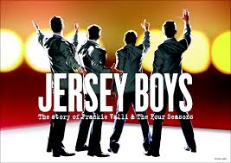
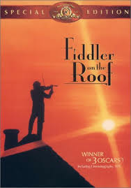
The musical is America’s primary contribution to world theatre
It is among the most popular forms of theatre

Slide 3
Elements of a musical
Music that stands alone
Music combined with lyrics
Lyrics
Spoken dialogue
Music is implicit/ evocative. Specific to the setting.
Lyrics- different kinds of songs
Opening number
Character song
Dance number
11:00 song
finale

Slide 4
Elements continued
Libretto- long VS short. Outline of dramatic development
Dance- not in all musicals. Advances the plot, establishes plot & atmosphere, comedy, spectacle, transcends spoken language.
Music in drama goes all the way back to the Ancient Greeks. It is the specific structure that makes the American musical unique.

Slide 5
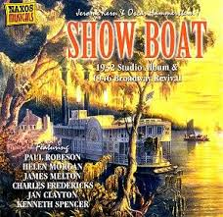
The birth of the musical
Late 19th / early 20th century- music takes precedence over spoken lyrics/ story. Oftentimes, these musicals were just a number of songs strung together.
http://www.youtube.com/watch?v=yyJtGNk9iEU

Slide 6
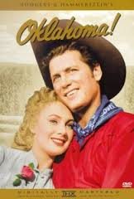
The Golden Age of Musical Theatre
Rogers & Hammerstein
Lerner & Loewe
Harnick and Bock
Characters are ordinary people
All songs & dances are in service to the plot- focus becomes on story.
Optimistic world view
http://www.youtube.com/watch?v=KNEUtN21cuU

Slide 7
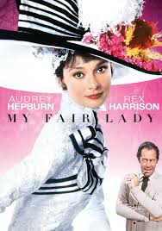
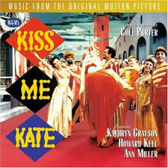
‘Book’ musicals/ Rise of the choreographer
Many famous ‘book’ musicals are adaptations of straight plays:
Jerome Robbins, Agnes de Mille, Bob Fosse

Slide 8
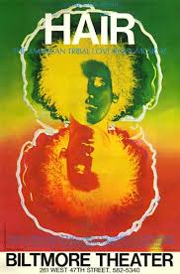

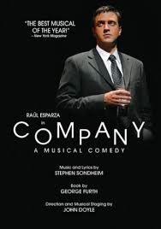
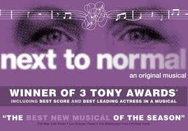
Beyond the Golden Age

Slide 9
Reactions
Loose plot structure
Emphasis on profanity/ nudity
Not always happy endings
Darker themes
Dissonant music
http://www.youtube.com/watch?v=omD3m-xwBWk

Slide 10
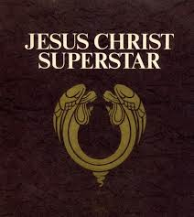
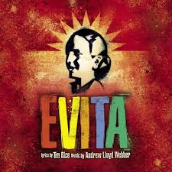
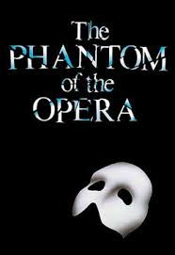
Andrew Lloyd Webber

Slide 11
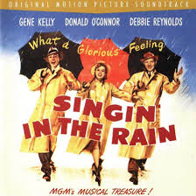
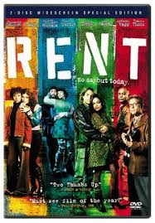

The Rise and Fall of the movie musical

Slide 12
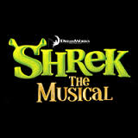

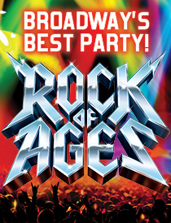
The current climate of musicals
Revivals
musical reviews
musicals based on films/ plays

